Slide 1
Authenticating People
Andrei Petrovski
( a.petrovski@rgu.ac.uk)
CM530– System Programming and Security

Slide 2
Overview
Elements of Authentication
Passwords
Evolution of Password Systems
Password Guessing
Attacking Password Biases
Authentication Tokens
Biometrics
School of Computing Science and DM, RGU

Slide 3
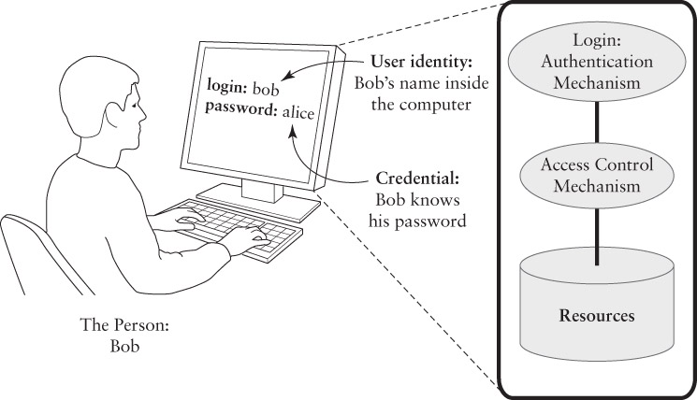
Elements of Authentication
An authentication system makes it as hard as possible for one user to masquerade as another by forging a credential.

Slide 4
Authentication Factors
Something you know
Password or Pin
Something you have
Key or token
Something you are
Personal trait

Slide 5
Multi-Factor Authentication Defense-in-Depth principle
Using different factors in authentication
NOT two or three instances of the same factor
Two-factor authentication
ATM authentication: ATM card + PIN
Biometric laptop: Fingerprint + password
NOT: Password + PIN
Three-factor authentication
Biometric access card: fingerprint+card+PIN
NOT: fingerprint+PIN+password

Slide 6
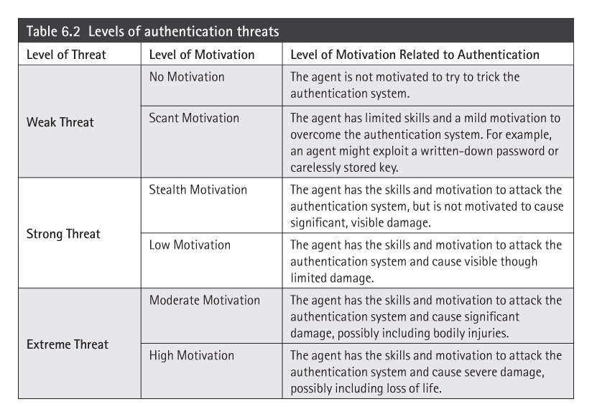
Authentication Threats
Focus on isolated computer systems
Trick the authentication system or access assets through the system
No “remote” attacks via Internet or LAN
Threats must have physical access to system
Range of threats
Weak Threat – authentication is effective
Strong Threat – authentication may work
Extreme Threat – authentication not effective

Slide 7
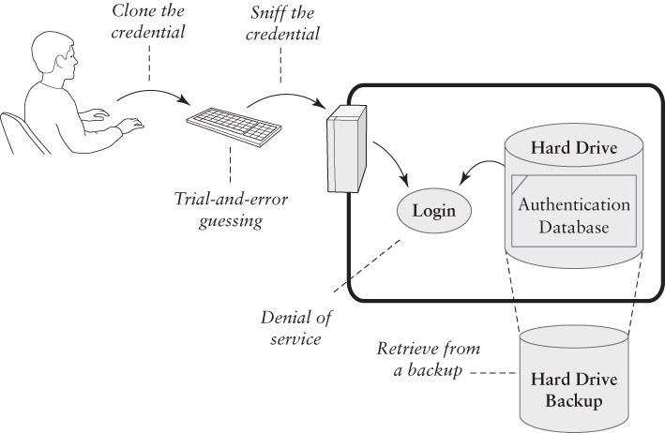
Attacks on Authentication

Slide 8
Something you know: Password authentication

Slide 9
Password Authentication
Each User ID is associated with a secret
User presents the secret when logging in
System checks the secret against the authentication database
Access granted if the secret matches
Risks
Shoulder surfing at the keyboard
Reading the password off of printer paper
Sniffing the password in transit or in RAM
Retrieving the authentication database

Slide 10
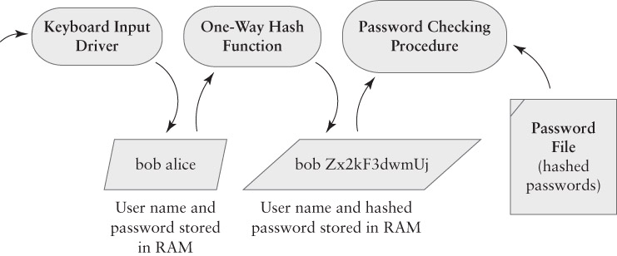
Password Hashing

Slide 11
One-Way Hash Functions
A Cryptographic Building Block function
We will see more building blocks later
Input:
An arbitrarily large amount of data, from a few bytes to terabytes – RAM or files or devices
Output:
A fixed-size result
Impractical to reverse
Minor change to input = big change to output

Slide 12
Salt
Unix password line
walt:fURfuu4.4hY0U:129:129:Belgers:/home/walt:/bin/csh
Compare
Salt
Input
Key
25x DES
Ciphertext
Plaintext
When password is set, salt is chosen randomly

Slide 13
Advantages of salt
Without salt
Same hash functions on all machines
Compute hash of all common strings once
Compare hash file with all known password files
With salt
One password hashed 2¹² different ways
Precompute hash file?
Need much larger file to cover all common strings
Dictionary attack on known password file
For each salt found in file, try all common strings

Slide 14
Sniffing Passwords
Goal: intercept the password before it is hashed
Keystroke loggers
In Hardware: devices that connect to a keyboard’s USB cable
In Software: procedures that eavesdrop on keyboard input buffers

Slide 15
Password Guessing
DoD Password Guideline (1985) required a minimum 1 in a million chance of successful guessing.
This was designed to defeat interactive password guessing: a person or machine made numerous guesses
Some guessing succeeds based on social and personal knowledge of the targeted victim
Modern network-based guessing can try tens of thousands of alternatives very quickly.
John the Ripper | John the Ripper is a fast password cracker, currently available for many flavours of Unix (11 are officially supported, not counting different architectures), Windows, DOS, BeOS, and OpenVMS.
Hydra | A very fast network logon cracker which support many different services. Number one of the biggest security holes are passwords, as every password security study shows.
Medusa | Medusa is intended to be a speedy, massively parallel, modular, login brute-forcer. The goal is to support as many services which allow remote authentication as possible.
Ophcrack | Ophcrack is a Windows password cracker based on rainbow tables. It is a very efficient implementation of rainbow tables done by the inventors of the method.
RainbowCrack | RainbowCrack is a general propose implementation of Philippe Oechslin's faster time-memory trade-off technique.
The ssh bruteforcer | Is a tool to perform dictionary attacks to the SSH servers, it's a simple tool, you set the target server, target account, wordlist, port and wait..

Slide 16
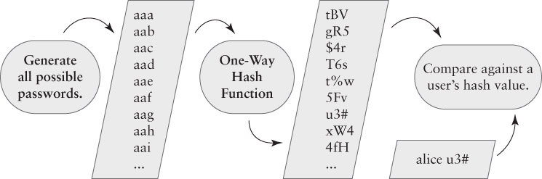
Off-line Password Cracking

Slide 17
How fast is off-line cracking?
It depends on the size of the search space
I.e. how many legal – or likely – passwords?
Legal passwords are limited to specific sets of characters, typically from the ASCII set
Single-case letters only:
Two letter passwords = 26²
Three letter passwords = 26³
… etc.
Password with L letters = 26^{L}

Slide 18
Increasing the search space
Two options
Increase L – the length of passwords
Increase A – the range of letters and other characters in the password’s alphabet
Also called the character set
Search space for fixed length password = A^{L}
Search space for range of lengths from 1 to L
A summation of individual lengths
Reduces to algebra: (A^{L+1} – 1)/(A – 1)

Slide 19
Speed of Cracking
Varies with different hardware and assumptions
Best case: cracking with a desktop computer
Bad case: using custom hardware
Worst case: using the limits of physics
Cracking technology | Tests completed | Estimated time
Desktop | 10⁹ | Hours
DES Cracker | 10¹⁸ | Days
Physical limit of Sun’s energy | 10⁷⁵ | Ten billion years

Slide 20
Exploiting Password Bias
Attacker does not try every possible password
Restricts the search space to likely passwords
Morris worm successfully used this attack
Similar attack used by Anonymous and Lulz in 2011 to extract passwords from hashes
A dictionary attack
Uses a list of likely passwords as the password space
There are far fewer likely passwords than possible passwords

Slide 21
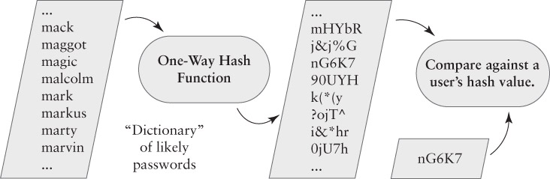
A Dictionary Attack

Slide 22
Dictionary Attacks Work
The attacks do not recover all passwords, but they recover enough to make them worthwhile
Exploit the likelihood that some users choose weak passwords
Research or Incident | % Guessed
Morris worm, estimated success (1988) | ~50%
Klein’s Study (1990) | 24.2%
Spafford’s Study (1992) | 20%
CERT Incident 1998-03 | 25.6%
Cambridge study by Yan, et al. (2000) | 35%
Lulz and Anonymous, estimated success (2011) | 30%

Slide 23
Assessing Bias-based attacks
Entropy in data indicates the likelihood that a particular message may appear
It considers the range of possible messages and the likelihood of each one
Randomly chosen characters have more entropy that readable text
Language enforces a bias in the choice of letter sequences
Estimated entropy in English text is 1 to 3 bits per character

Slide 24
Average Attack Space
An estimate of the likelihood that a trial-and-error attack will succeed against a community
We construct a dictionary of passwords that the community is likely to use
We estimate the likelihood that the community chooses those passwords
V = S / (2L)
V = # of trials for a 50% chance of success
S = size of the search space (dictionary)
L = Likelihood that users choose from dictionary

Slide 25
An Example: 4-digit Luggage Lock
Assume that there are hundreds of these locks being used
25% of the owners pick a 4-digit date as the combination
1 out of 366, not 1 out of 10000
V = 366 / (2 x .25)
V = 732
50% chance of success requires 732 date trials, not 5000
Must try different locks at random!

Slide 26
Password Ping-Pong
Attacks
Defenses
??
One-Time Passwords
Network Sniffing
Password Tokens
Password Sharing
Memory Protection
Keystroke Sniffing
Help Desk Restrictions
Social Engineering
Guess Detection
Guessing
Password Hashing
Steal the Password File
Passwords

Slide 27
Security of a password authentication scheme
Should withstand the following attacks:
Denial of Service Attacks: an attacker can update false verification information of a legal user for the next login phase.
Forgery Attacks (Impersonation Attacks): an attacker attempts to modify intercepted communications to masquerade the legal user and login to the system.
Parallel Session Attacks: without knowing a user’s password, an attacker can masquerade as the legal user by creating a valid login message out of some eavesdropped communication between the user and the server.
Password Guessing Attacks: an attacker intercepts authentication messages and stores them locally and then uses a guessed password and seeks verify the correctness of their guess using these authentication messages.
Replay Attacks: having intercepted previous communications, an attacker can replay the intercepted messages to impersonate the legal user to login to the system.

Slide 28
Something you have: authentication tokens

Slide 29
Authentication Tokens
Benefits
Hard to attack - uses a stronger secret than you get in a typical password
Hard to forge - must hack the hardware
Hard to share – secret stored in hardware
Problems
Expensive - must buy hardware and/or special authentication software
Can be lost or stolen
Risk of hardware failure

Slide 30
Types of Tokens
Passive Tokens – the most common
Stores an unchanging credential
Examples:
card keys for hotel rooms
Magnetic stripes on credit cards
Active Tokens – the most secure
Stores a secret that generates a different credential for each login
Examples:
one-time password tokens
Challenge Response tokens (older devices)

Slide 31
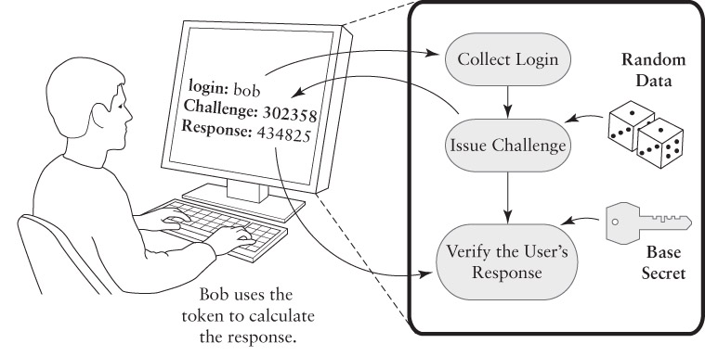
Challenge Response Authentication

Slide 32
Another Crypto Building Block
Challenge Response is a protocol
An exchange of data to yield a shared result
Four steps:
Bob says, “Authenticate me!”
Alice says, “The challenge is 56923”
Bob calculates the response and says, “The response is 17390.”
Alice checks Bob’s response against what she expected, using the same calculation
Calculation relies on a shared secret

Slide 33
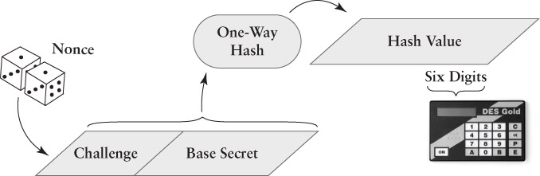
A challenge response calculation

Slide 34
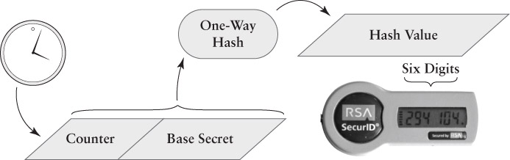
A one-time password token

Slide 35
Token Vulnerabilities
Clone or borrow credential
Borrowing is possible, but detectable
Cloning should be impractical
Sniffing and trial-and-error guessing
Both should be impractical
Denial of service
Token may be lost, damaged, or stolen
Retrieve from backup
Attacker could steal the authentication database – 2011 incident with SecurID

Slide 36
Something you are: biometric authentication

Slide 37
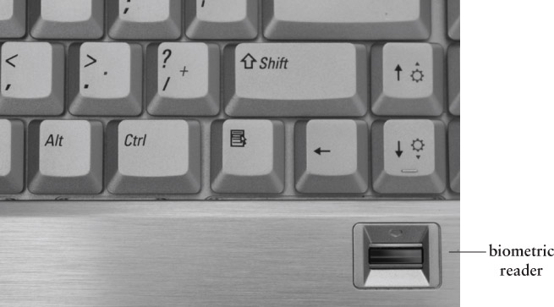
Biometric Authentication

Slide 38
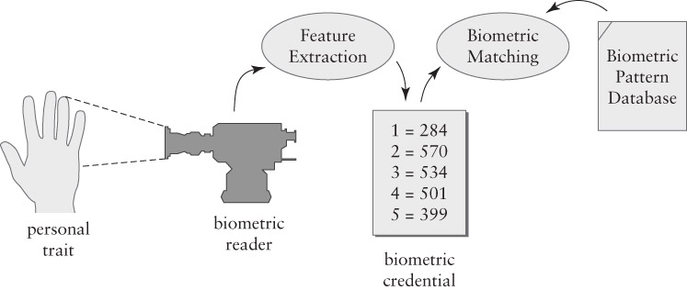
Elements of Biometric Authentication

Slide 39
Biometric Accuracy
Two types of errors
False acceptance – incorrectly detects a match with a credential and the database
False rejection – fails to detect a match between a credential and the database
False Acceptance Rate (FAR)
Likelihood of incorrectly authenticating someone as an authorized user
Average attack space = 1 / (2 x A_{FAR})
False Rejection Rate (FRR) – denial of service

Slide 40
Biometric Vulnerabilities
Clone or borrow credential – often
Demonstrated many times with fingerprints, faces, voices, etc.
Sniff the credential and replay – often
Possible in networked and remote systems
Trial and error guessing – slight
Requires a team of attackers
Denial of service – possible
Retrieve from backup – possible

Slide 41
Security Threat Environments

Slide 42
Authentication Policy and Requirements
Constructing a policy for an isolated computer
Answer these questions:
Is the computer used at home, at work, or both?
For each environment, are there threats?
For each threat, is it a weak or strong threat?
Weak threat: Might make an opportunistic attack on a vulnerable computer.
Strong threat: Will spend time and effort on an attack, if unlikely to be detected and/or caught

Slide 43
Weak Threat Environments
At Home
Avoid opportunities for shoulder surfing
Do not write down passwords that are at risk of being stolen
Passwords should be hard to guess and easy to remember
At Work – similar to home, except:
Passwords may be written down as long as the user keeps physical possession of the list
Authentication tokens may be used

Slide 44
Strong Threat Environment
Using Passwords
System should track failed password guesses to try to detect guessing attacks
Protect against keyboard sniffers
Pick passwords that resist off-line attacks
The system should provide “secure attention”
Other options:
Passwords plus tokens (Not for home use)
Passwords plus biometrics

Slide 45
Password Selection and Handling
Password selection
Choose passwords according to the risk faced by the assets it protects
Pick strong passwords for valuable assets
Use different passwords to protect different types of assets (if you reuse passwords)
Password protection
Keep an electronic, password-protected list
Keep a paper list of less critical passwords
Lock up a list of essential passwords safely

Slide 46
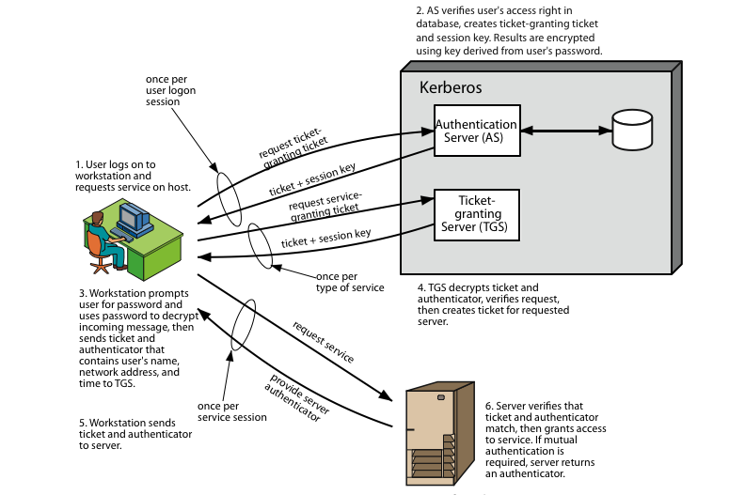
Kerberos Overview
Notes:
Stallings Figure 14.1 diagrammatically summarizes the Kerberos v4 authentication dialogue, with 3 pairs of messages, for each phase listed previously.

Slide 47
Kerberos Realms
A Kerberos environment consists of:
a Kerberos server
a number of clients, all registered with server
application servers, sharing keys with server
This is termed a realm
typically a single administrative domain
If have multiple realms, their Kerberos servers must share keys and trust

Slide 48
When NOT Use Kerberos
No quick solution exists for migrating user passwords from a standard UNIX password database to a Kerberos password database
such as /etc/passwd or /etc/shadow
For an application to use Kerberos, its source must be modified to make the appropriate calls into the Kerberos libraries
Kerberos assumes that you are using trusted hosts on an untrusted network
All-or-nothing proposition
If any services that transmit plaintext passwords remain in use, passwords can still be compromised

Slide 49

Certification Authorities
Certification authority (CA): binds public key to particular entity, E.
E (person, router) registers its public key with CA.
E provides “proof of identity” to CA.
CA creates certificate binding E to its public key.
Certificate containing E’s public key digitally signed by CA – CA says “this is E’s public key”
Bob’s
public
key
digital
signature
(encrypt)
+
K
+
B
K
B
CA
private
key
-
certificate for Bob’s public key, signed by CA
K
Bob’s
identifying information
CA
49
Notes:
CA is heart of the X.509 standard which has been used extensively in SSL (Secure Socket Layer), S/MIME (Secure/Multiple Purpose Internet Mail Extension), and IP Sec

Slide 50
Additional Reading
Elementary Information Security
Chapter 6 (Authenticating People)

